Slide 1
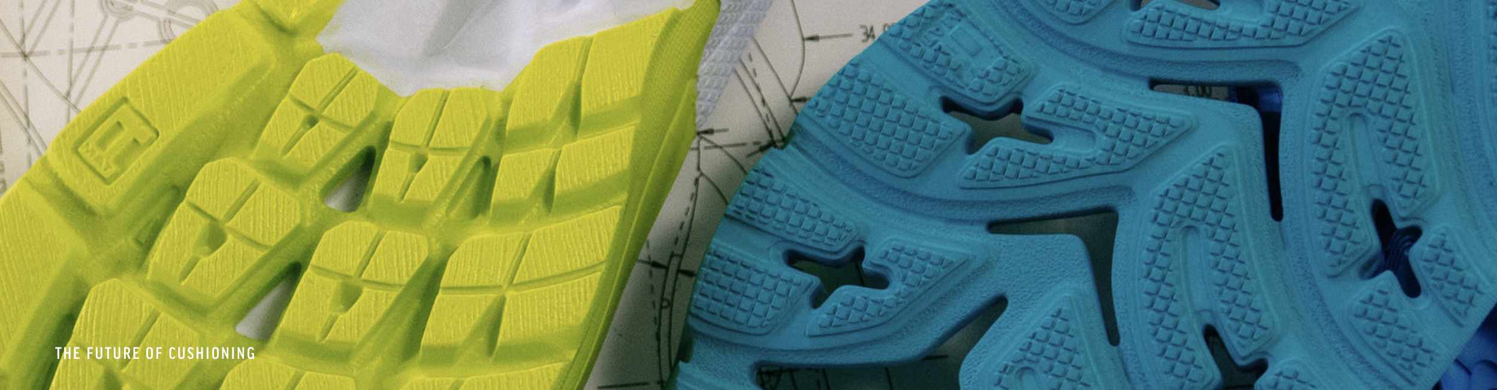

XYL INTRODUCTION
XYL
Since 2011
R-MAT Material Technology
Since 2011
R-MAT

Slide 2



Contents
01. XYL China Factory (DongGuan)
02. XYL Vietnam Factory (South)
03. R-Mat Material Introduction
R-MAT

Slide 3
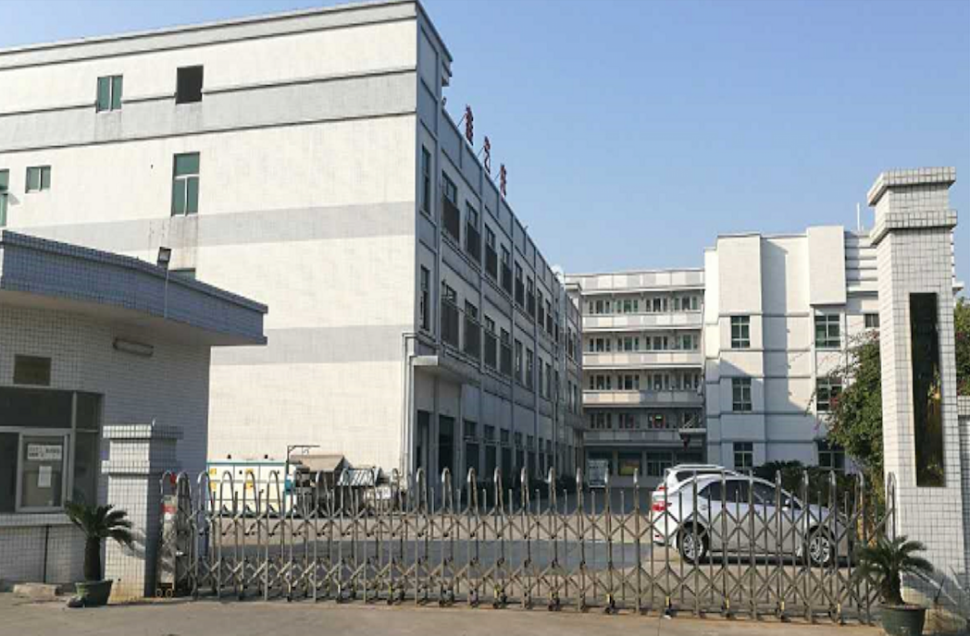

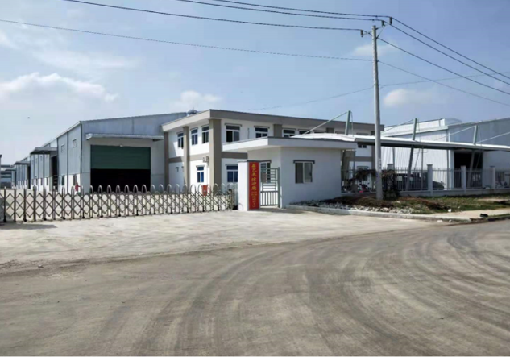
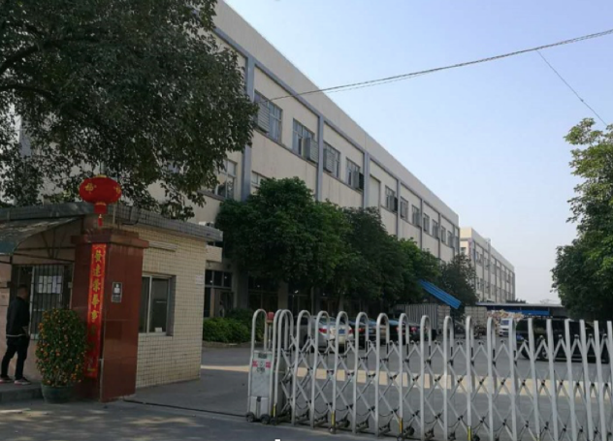
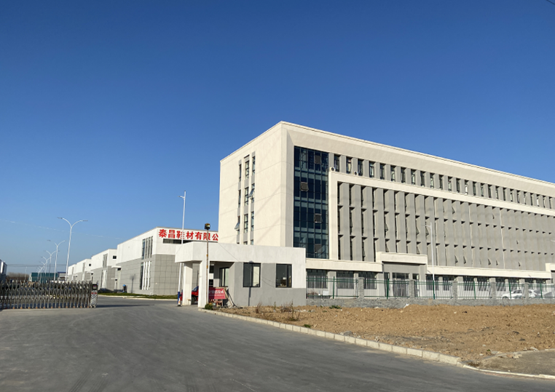

XYL
First Factory
DongGuan, China
XYL Factory
HeNan, China
XYL Factory
South Vietnam
2011
2021
2024
1997
2010
2016
R-MAT Factory
DongGuan, China
R-MAT Factory
HeNan, China
R-MAT Factory
South Vietnam
R-MAT
Milestone

Slide 4










R-MAT Cooperative Brand

Slide 5
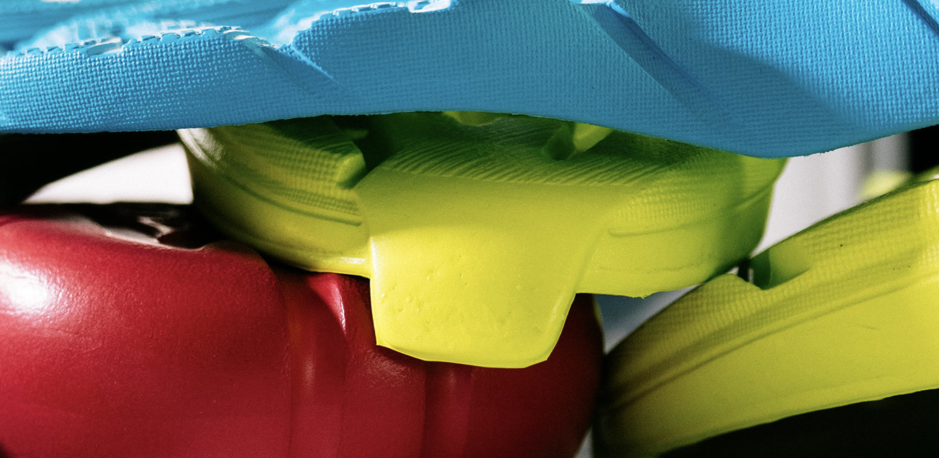
XYL China Factory (DongGuan)

Slide 6
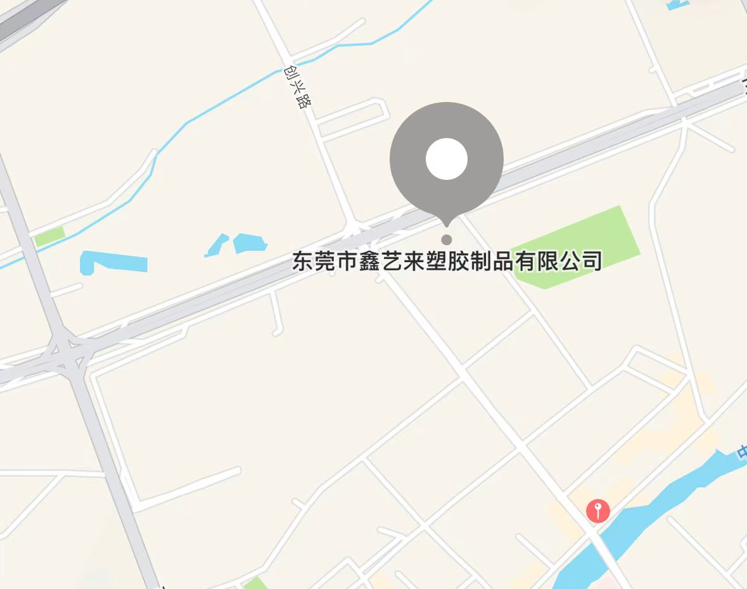

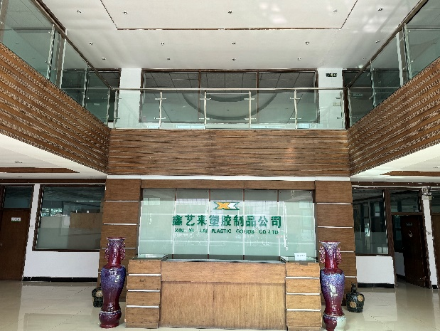
China Factory Profile (DongGuan)
1. Provides bottom components to Brand in China
2. Supplies raw materials to XYL’s global factories
3. XYL research and Development Innovation Center
4. Compression molded/Injection molded
Location
Area
Employee
R-MAT DongGuan: The Third Industrial Zone of Low Chong Village, GaoBu Town, DongGuan City
DongGuan Plant Area: 25000㎡
DongGuan Employee: 450 Technician: 20
R-MAT

Slide 7
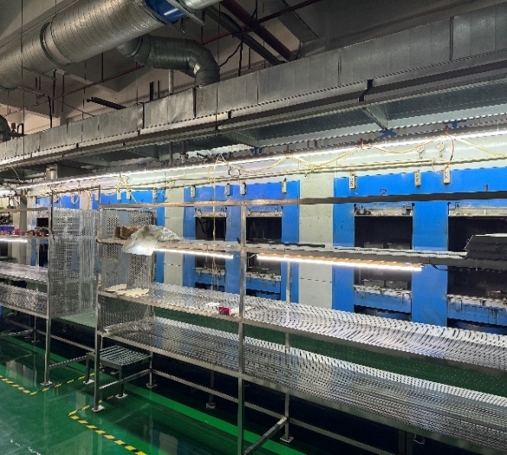
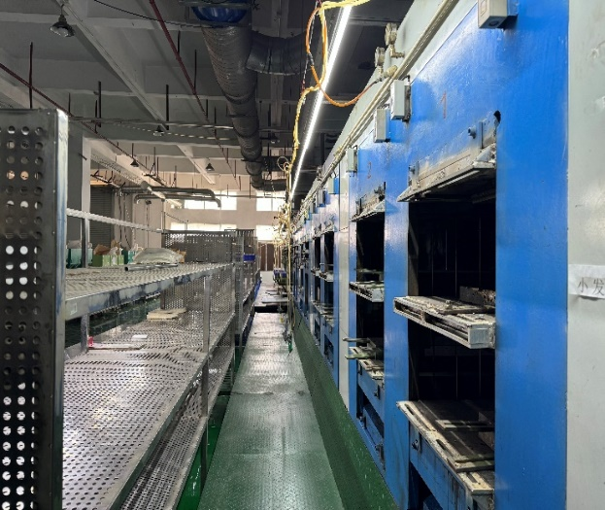
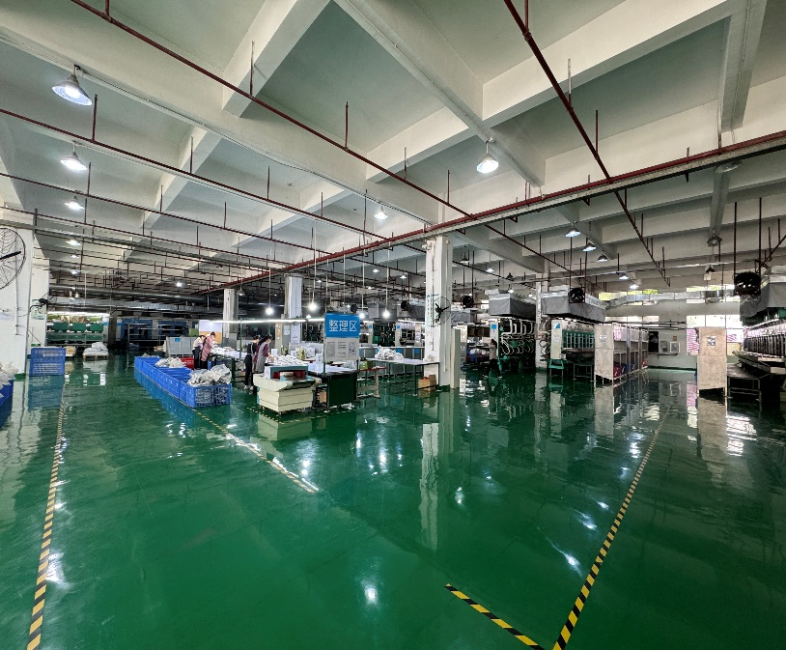
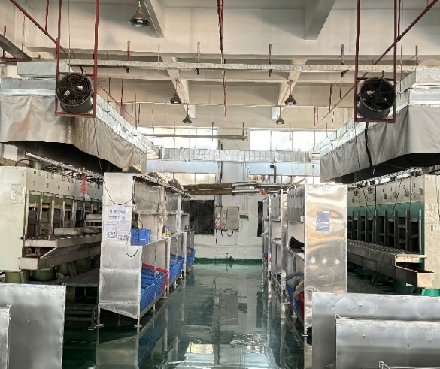
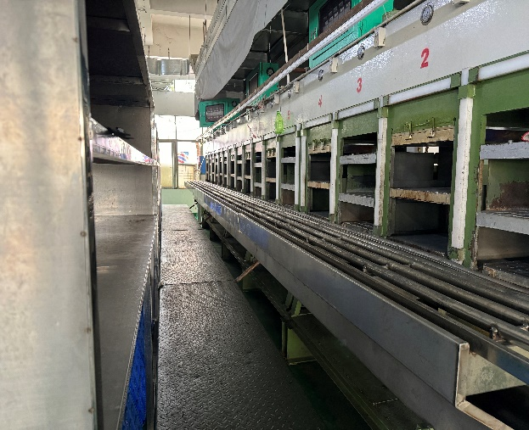
Compression Molded Workshop
Production Capacity
Monthly capacity: 600k
12 sets of compression machines
4 sets of foaming machines
R-MAT

Slide 8
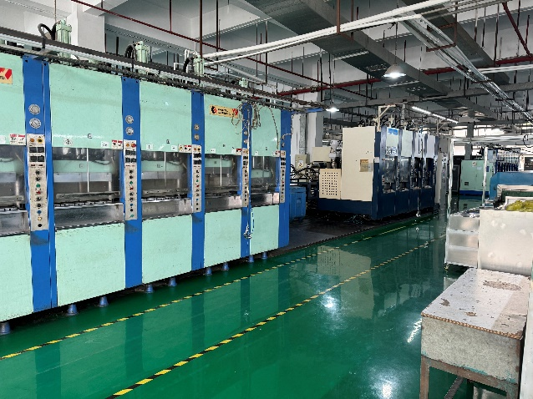
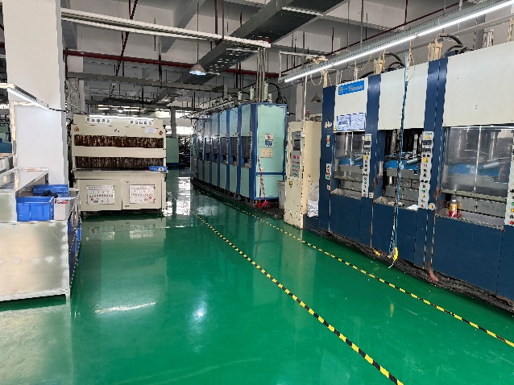
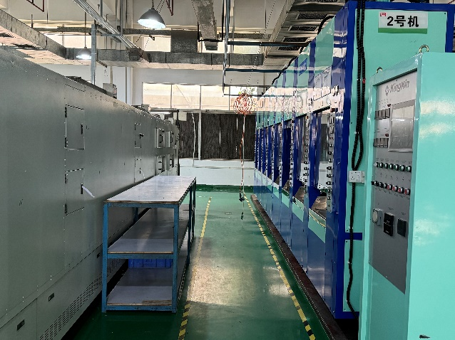
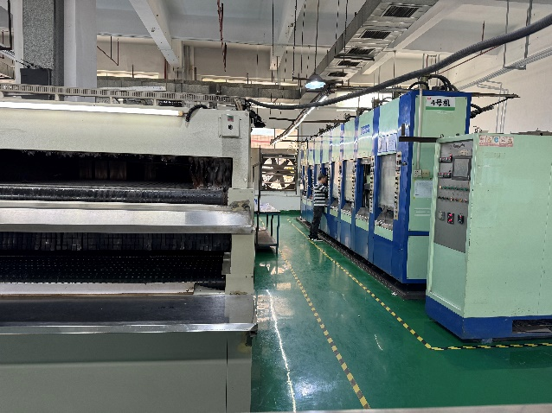
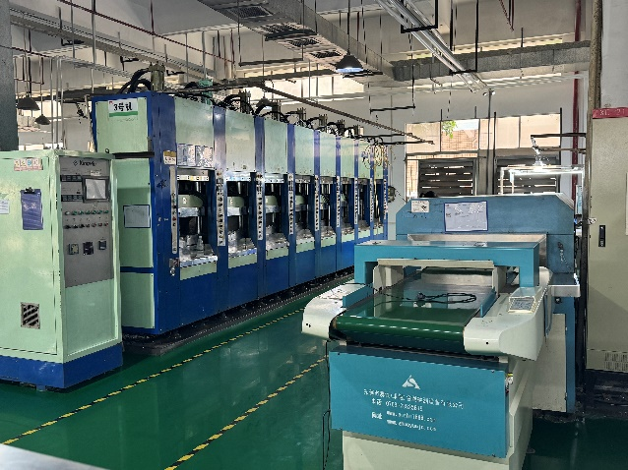
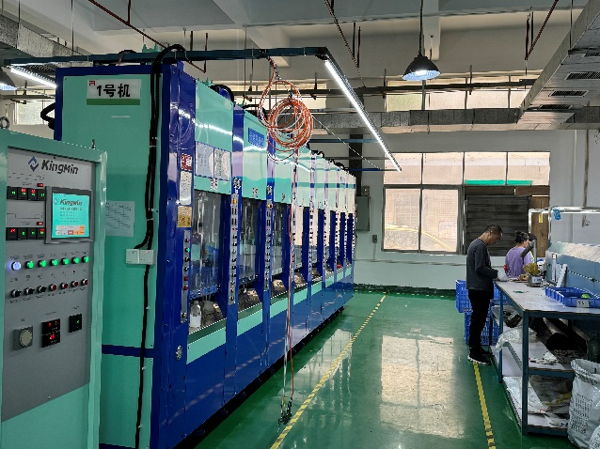
Injection Molded Workshop
Production Capacity
Monthly capacity: 700k
12 sets of injection machines
R-MAT

Slide 9
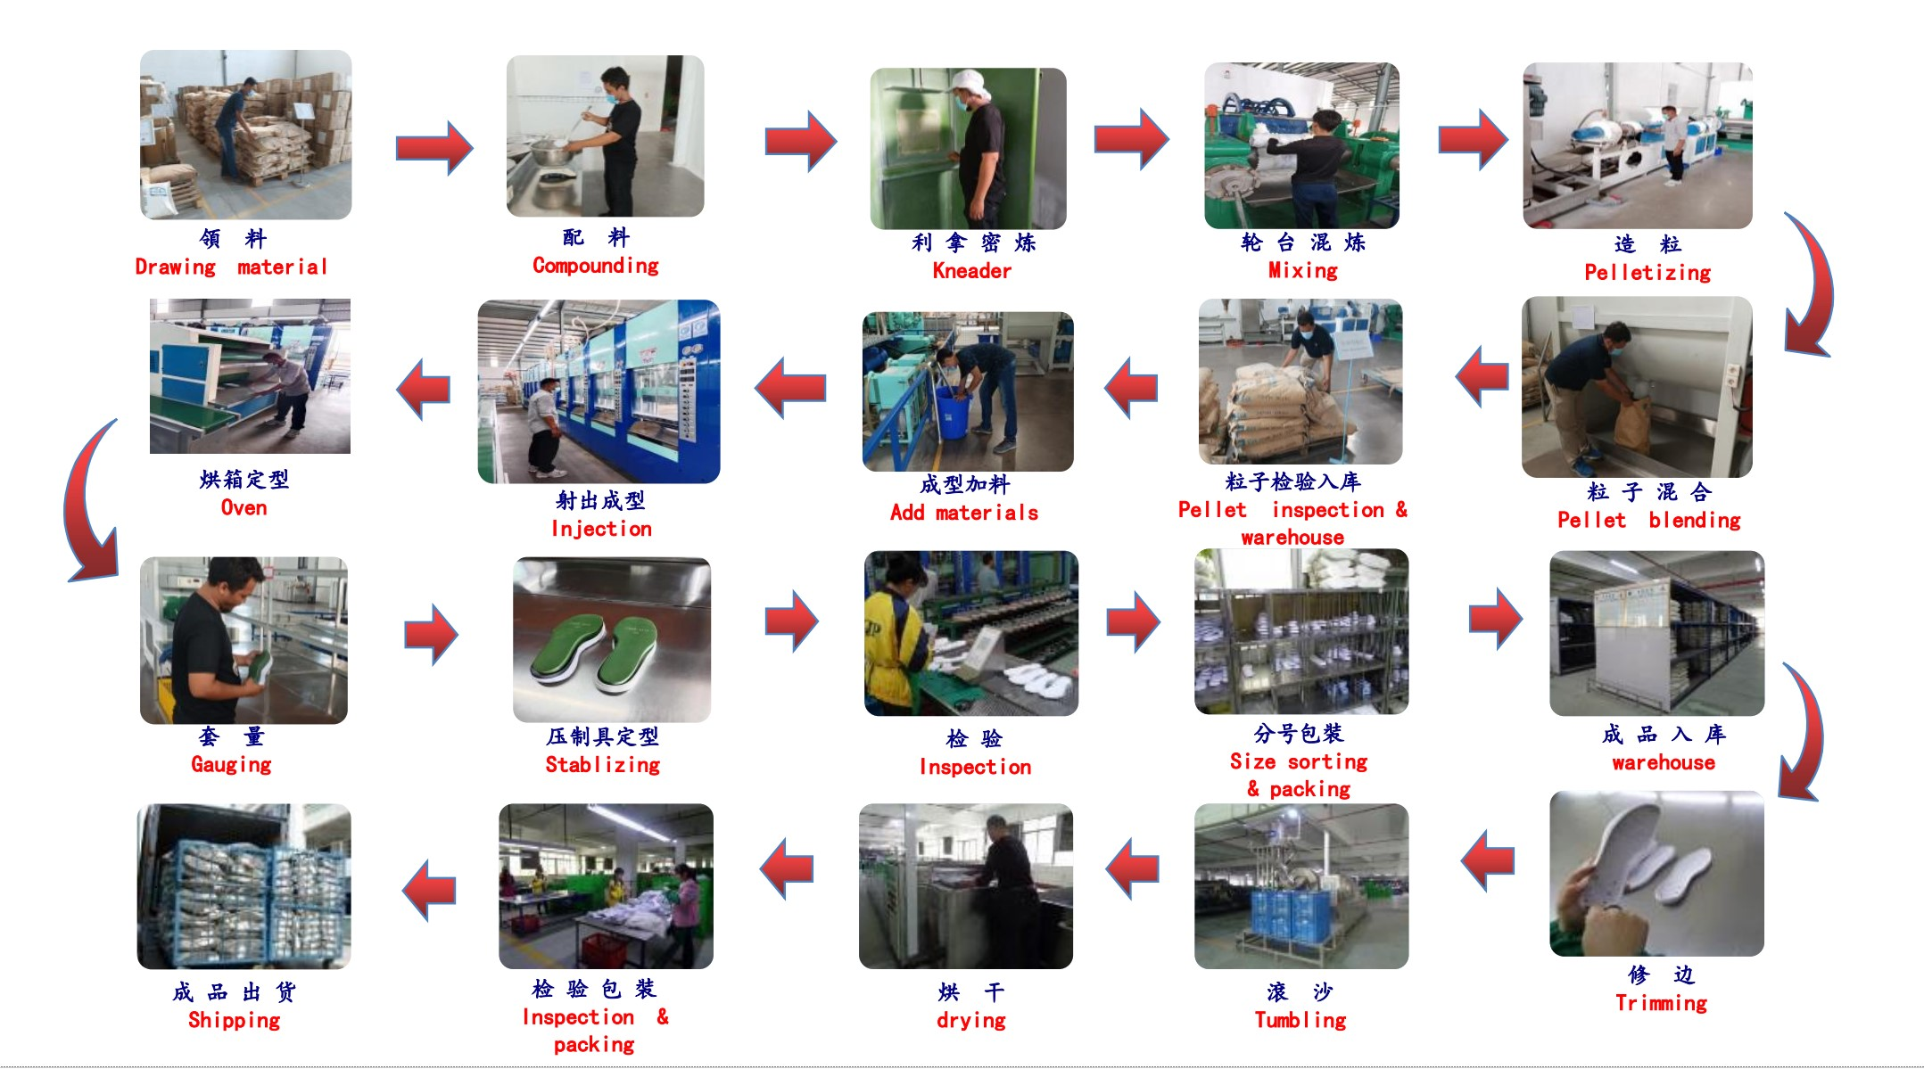
Production Process
R-MAT

Slide 10
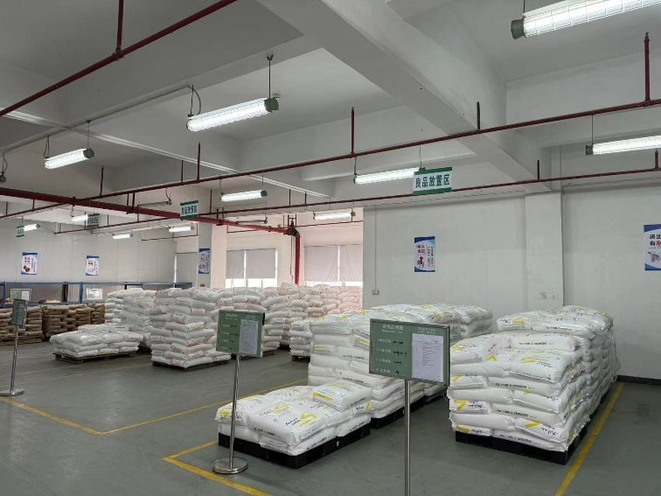
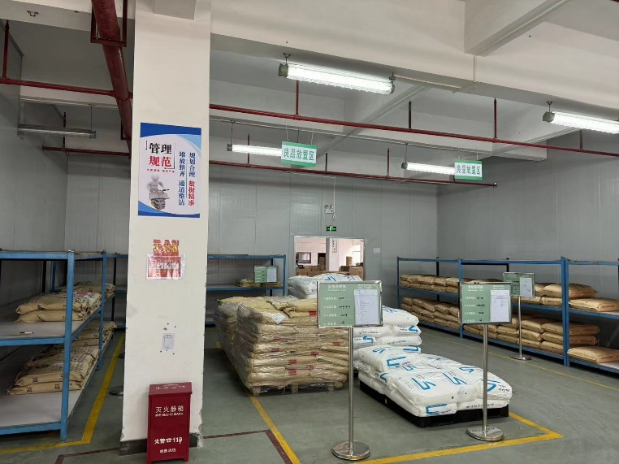
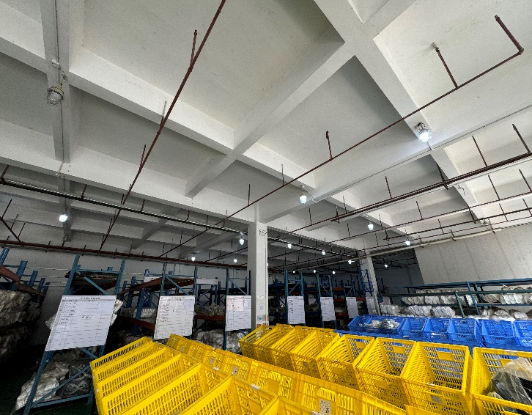
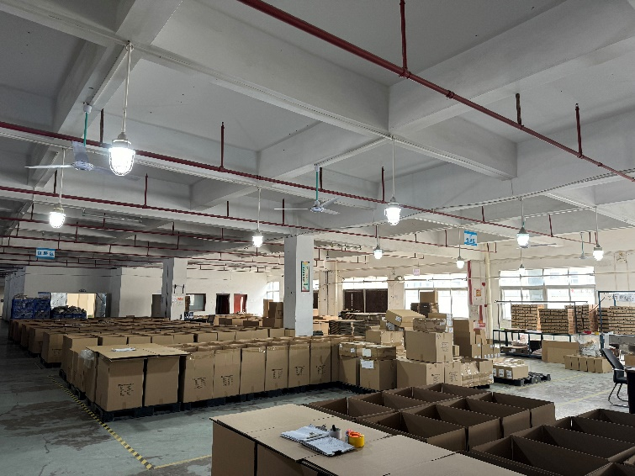
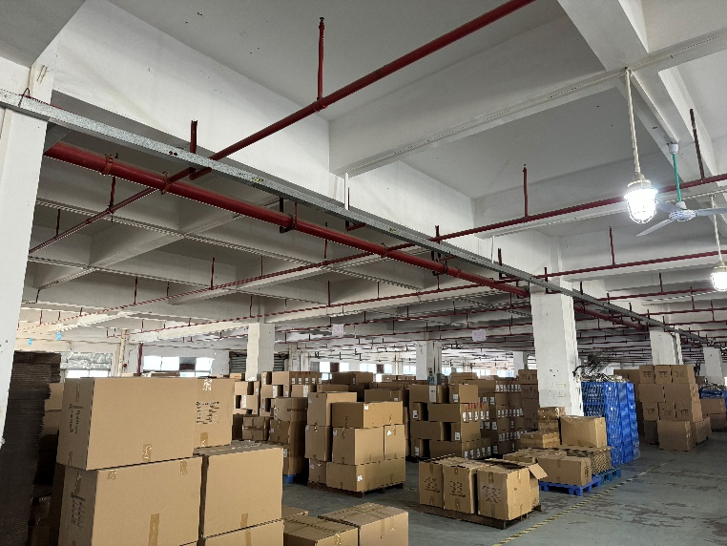
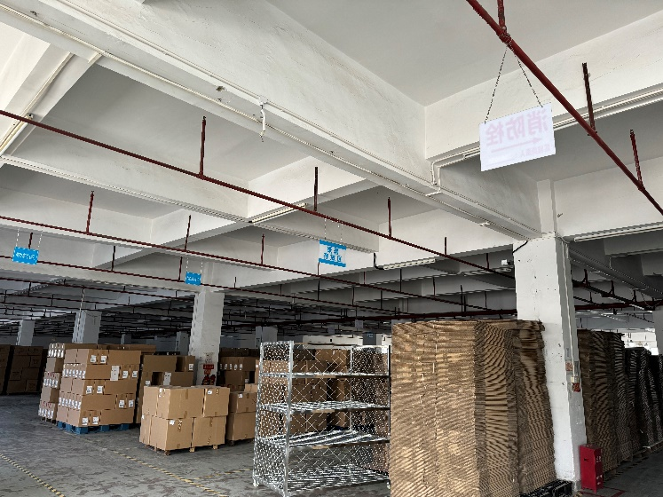
Warehouse

Slide 11
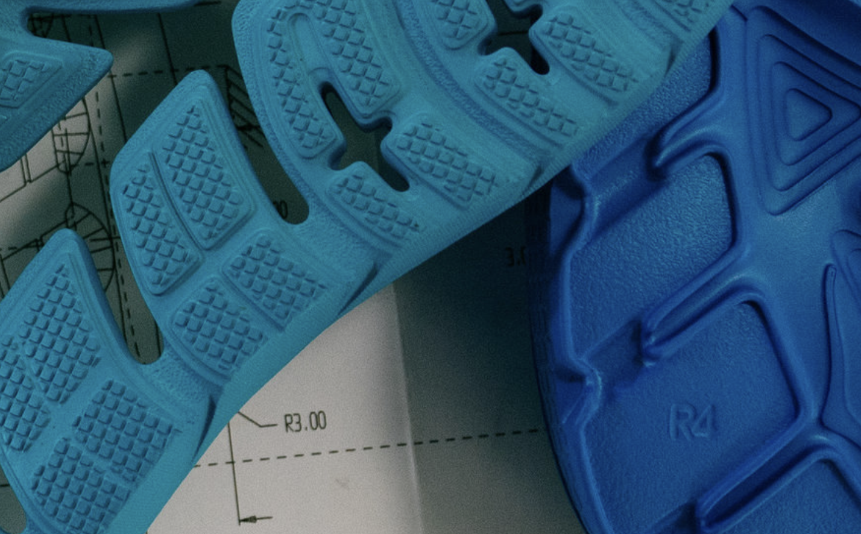
XYL Vietnam Factory (South)

Slide 12

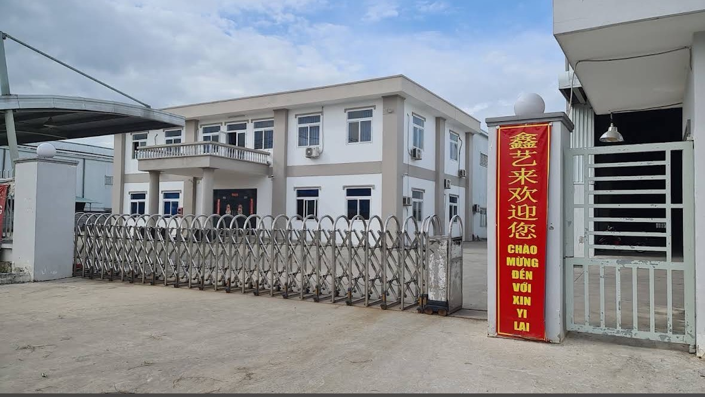
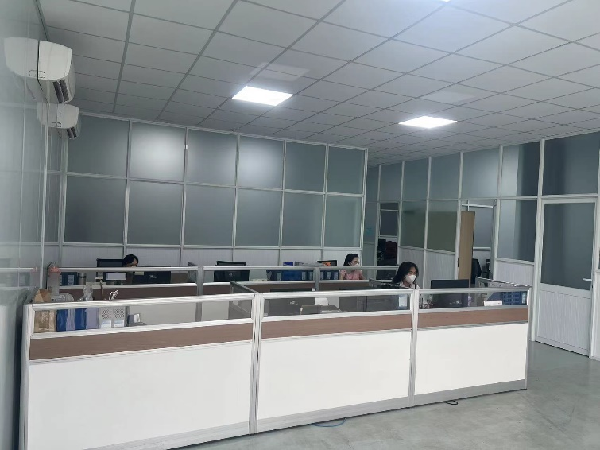
Vietnam Factory Profile (South Vietnam)
1. Provides bottom components to Brand in Vietnam
2. South factory has strong production capabilities, equipped with advanced machinery and a skilled team, allowing for efficient and stable large-scale production. The factory strictly follows quality control procedures to ensure products consistently meet high standards, while its flexible production lines can be adjusted to meet varying requirements
Location
Area
Employee
R-MAT South Vietnam: Binh Doung City
1 hours20mins from Ho Chi Minh Airport
South Vietnam Plant Area: 5800㎡
South Vietnam Employee: 100 Technician: 5
R-MAT

Slide 13
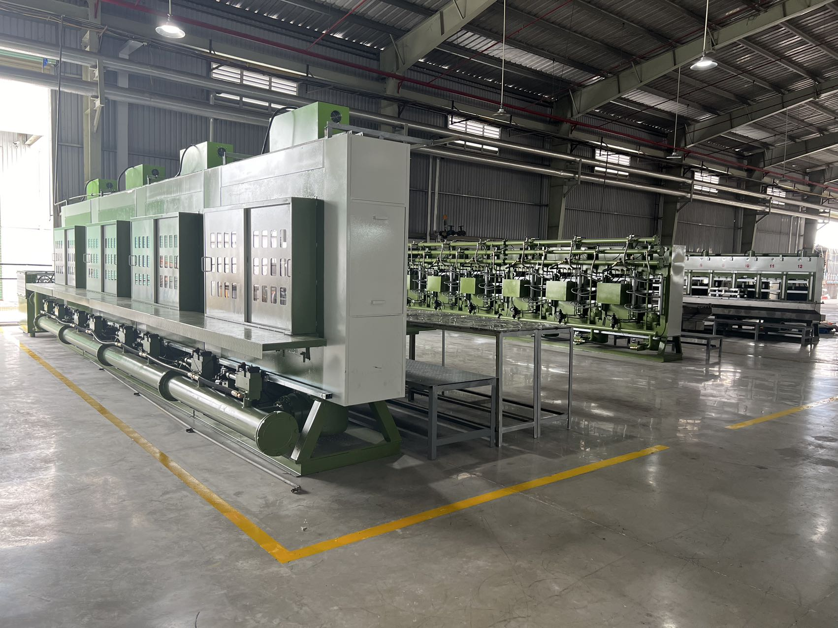
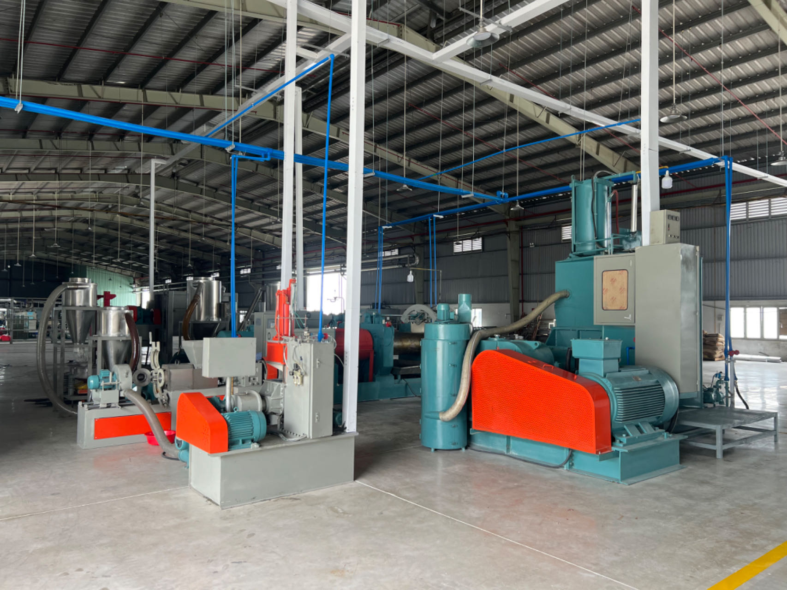
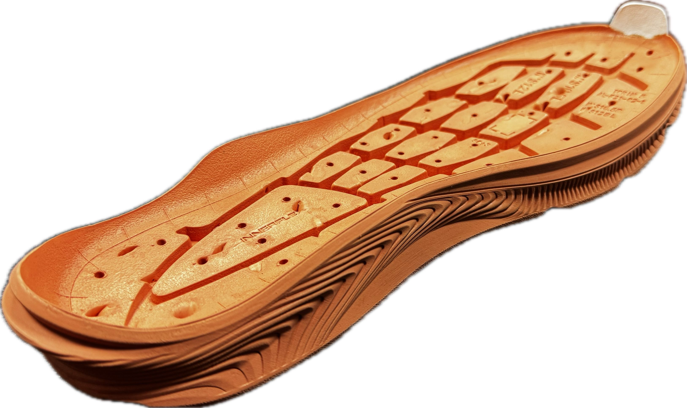
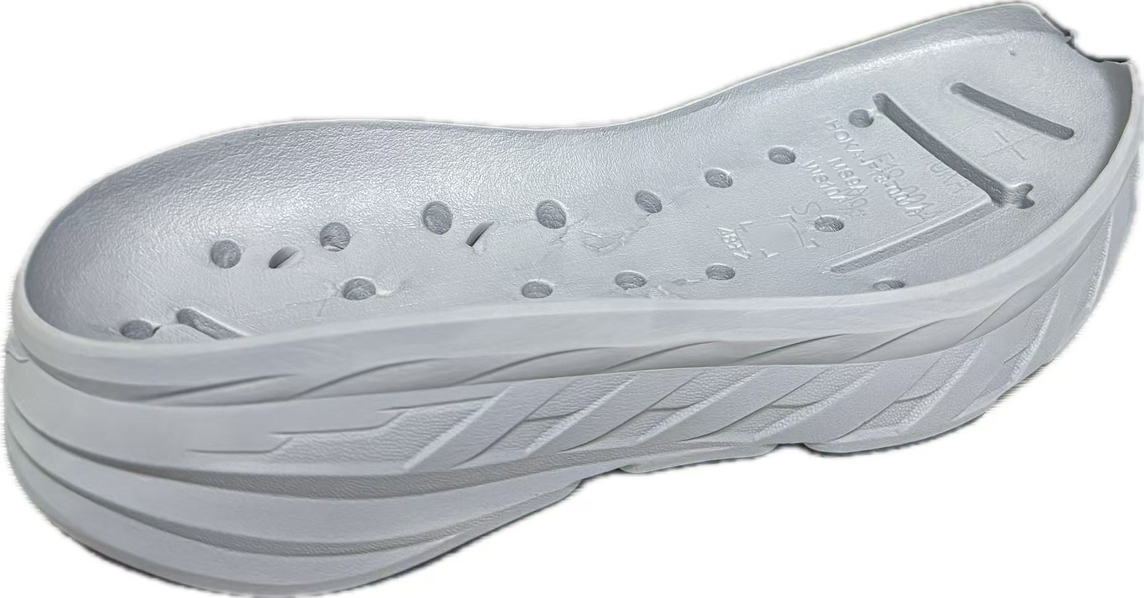
Compression Molded Workshop
Production Capacity
Monthly capacity: 150k/M
4 sets of compression machines
1 sets of foaming machines
R-MAT

Slide 14
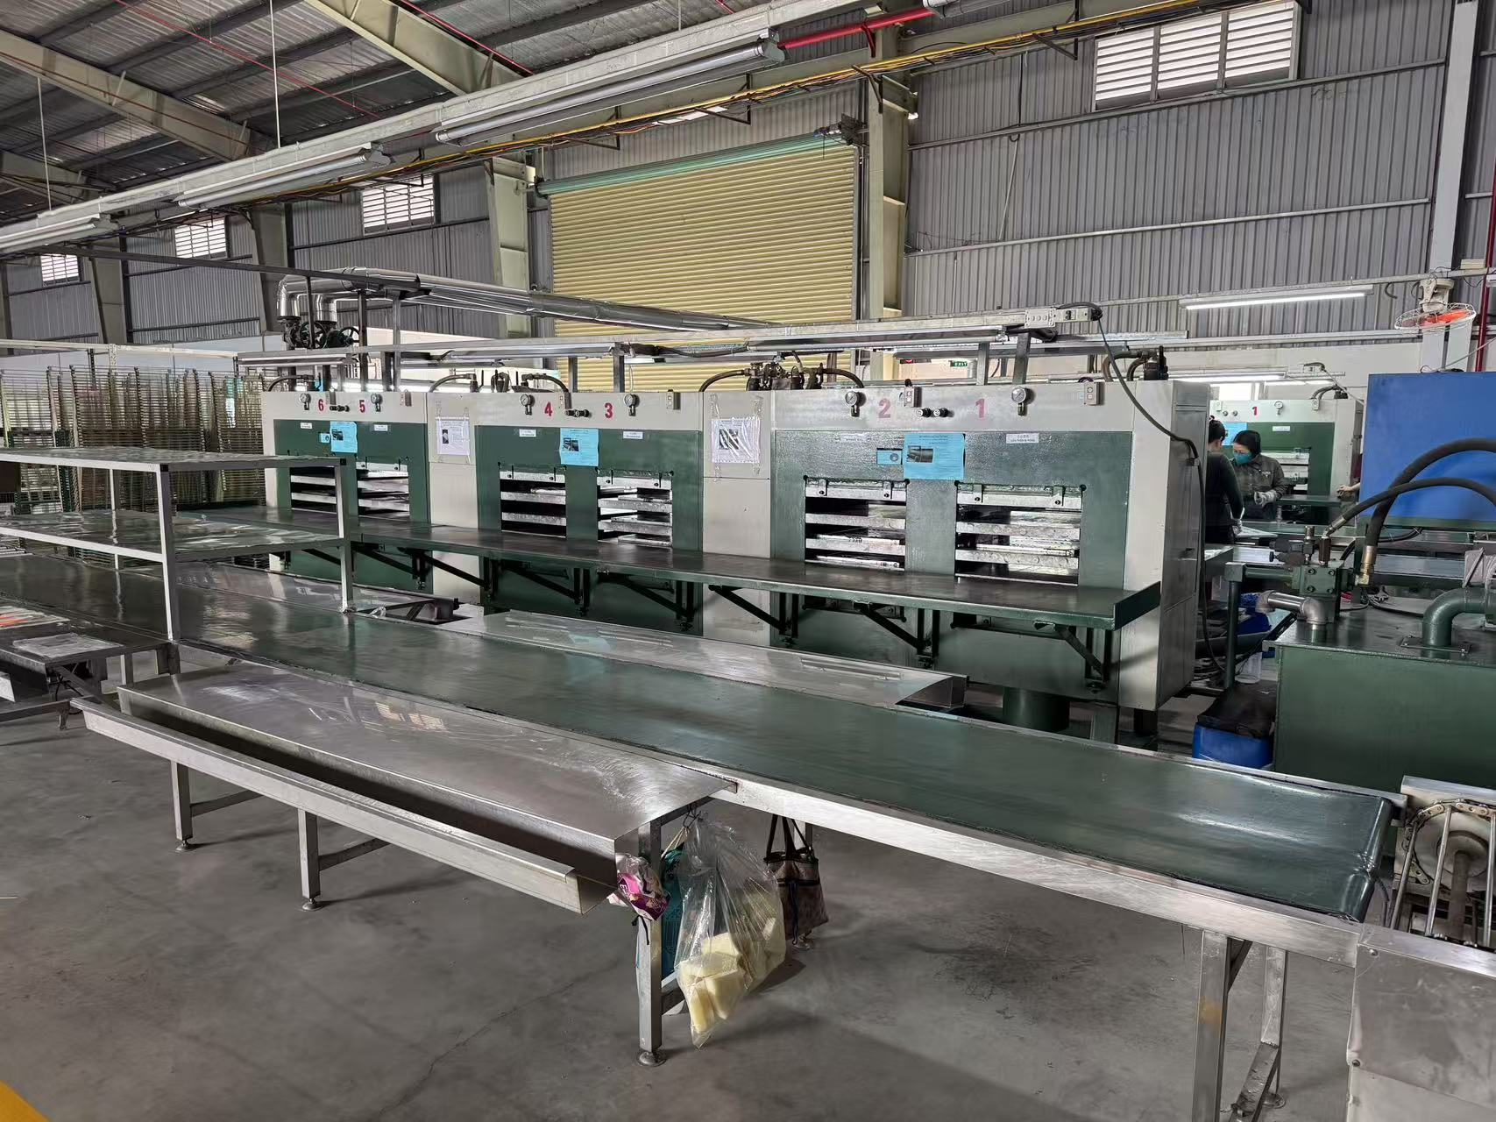
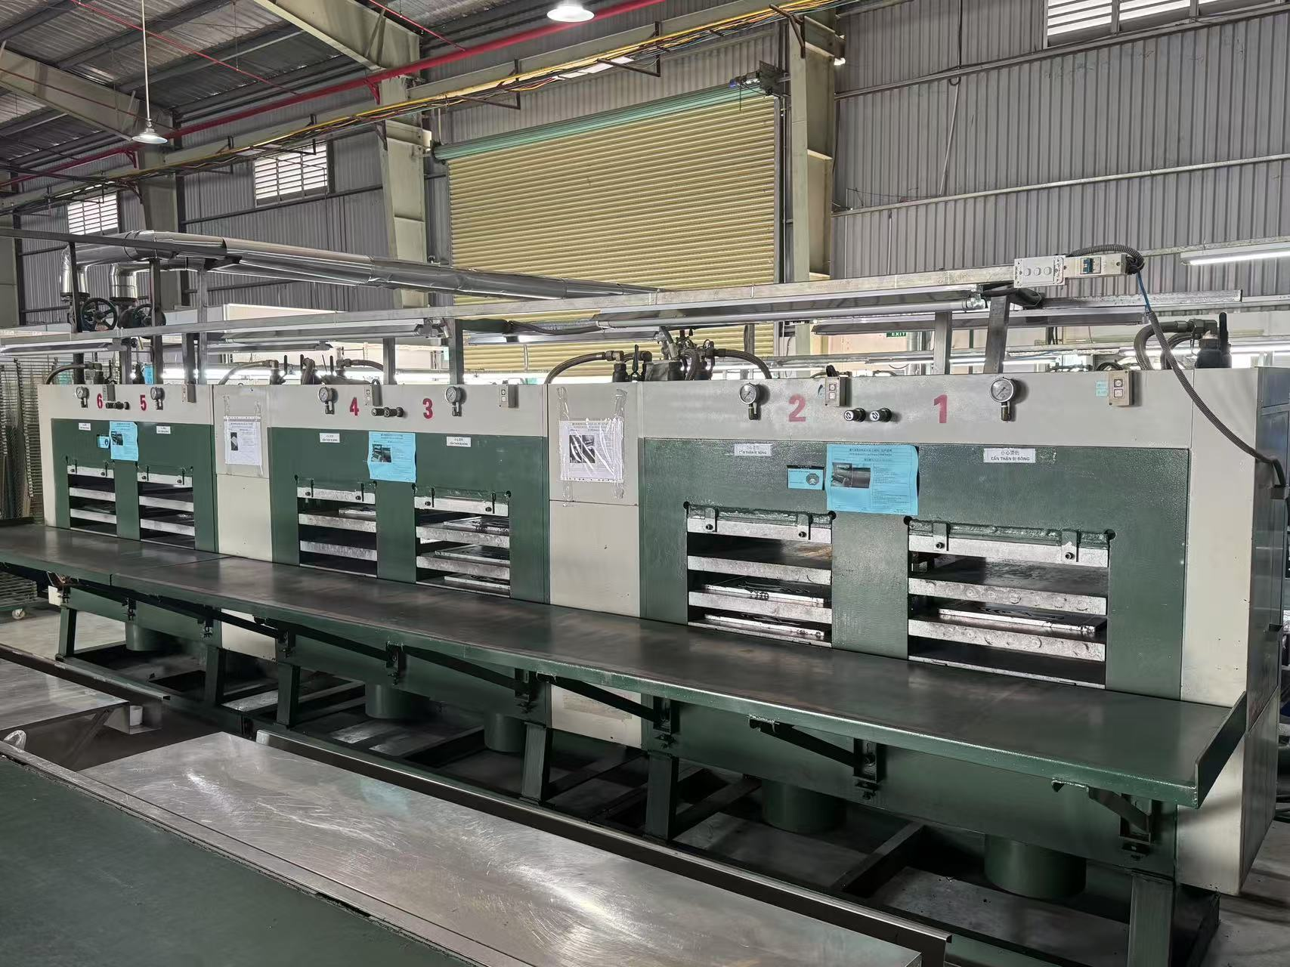
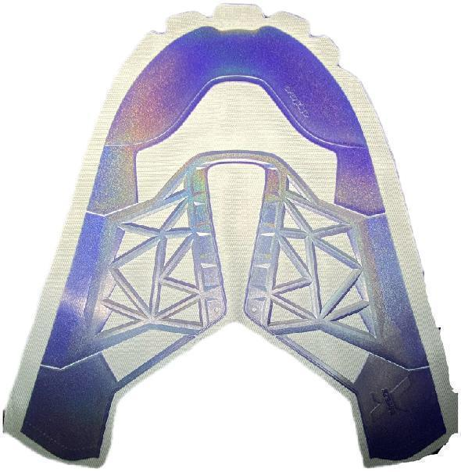
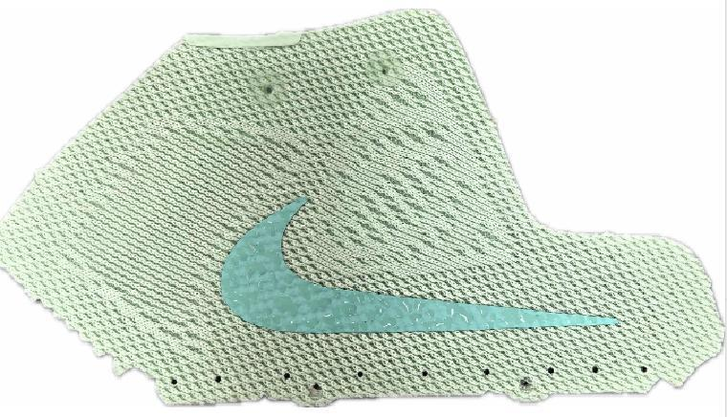
RPU Workshop
Production Capacity
Monthly capacity: 150K/M
2 sets of RPU machines

Slide 15
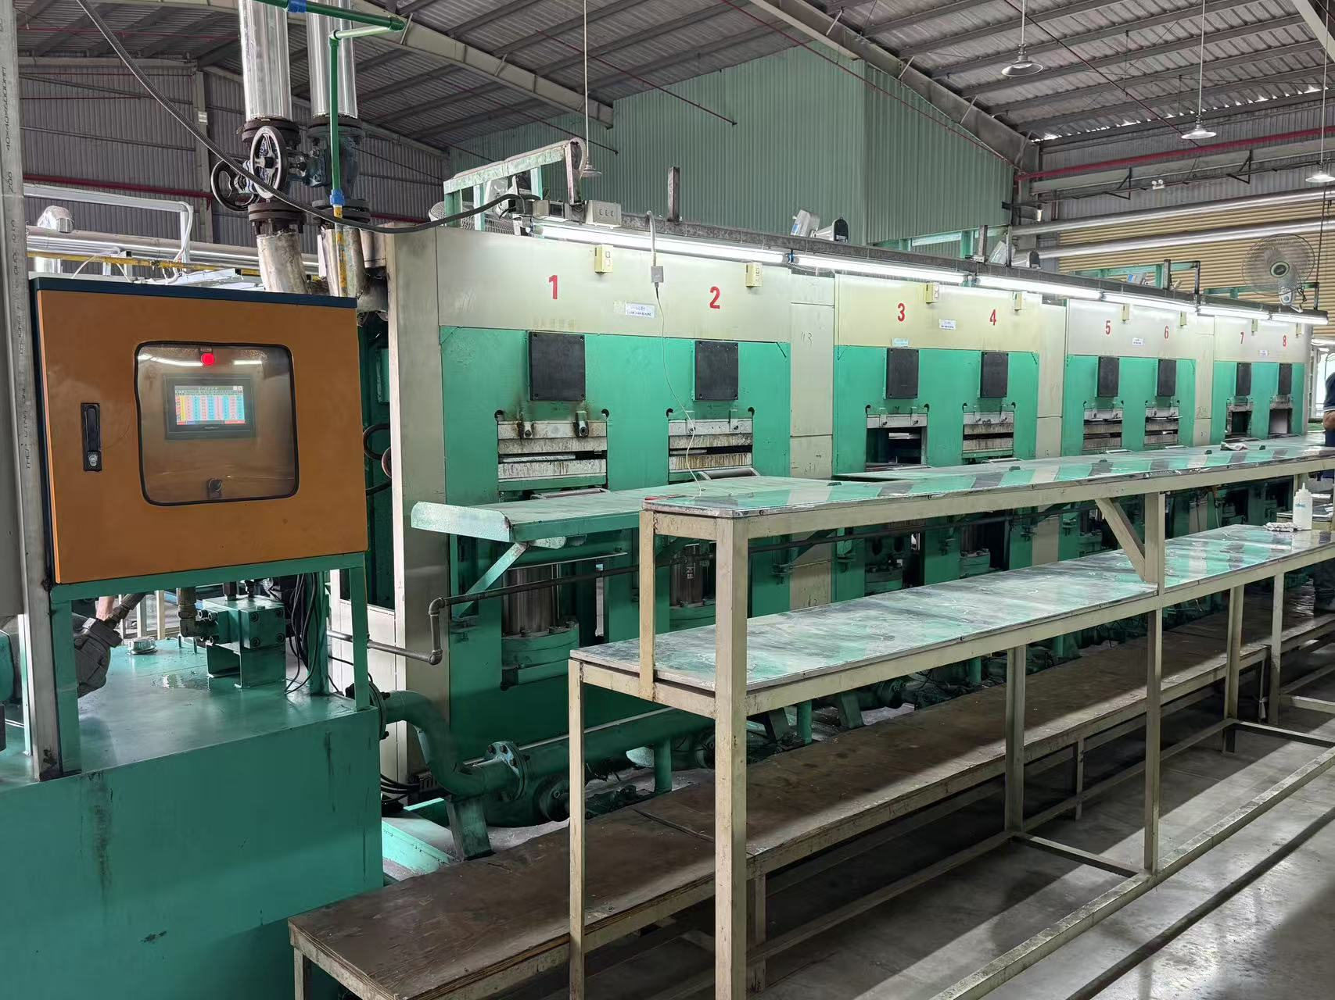
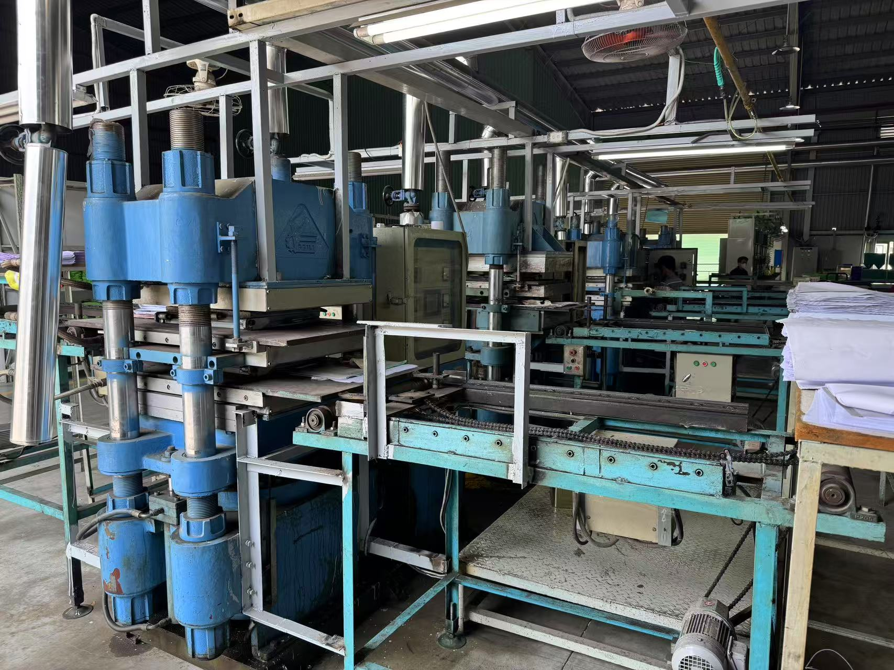
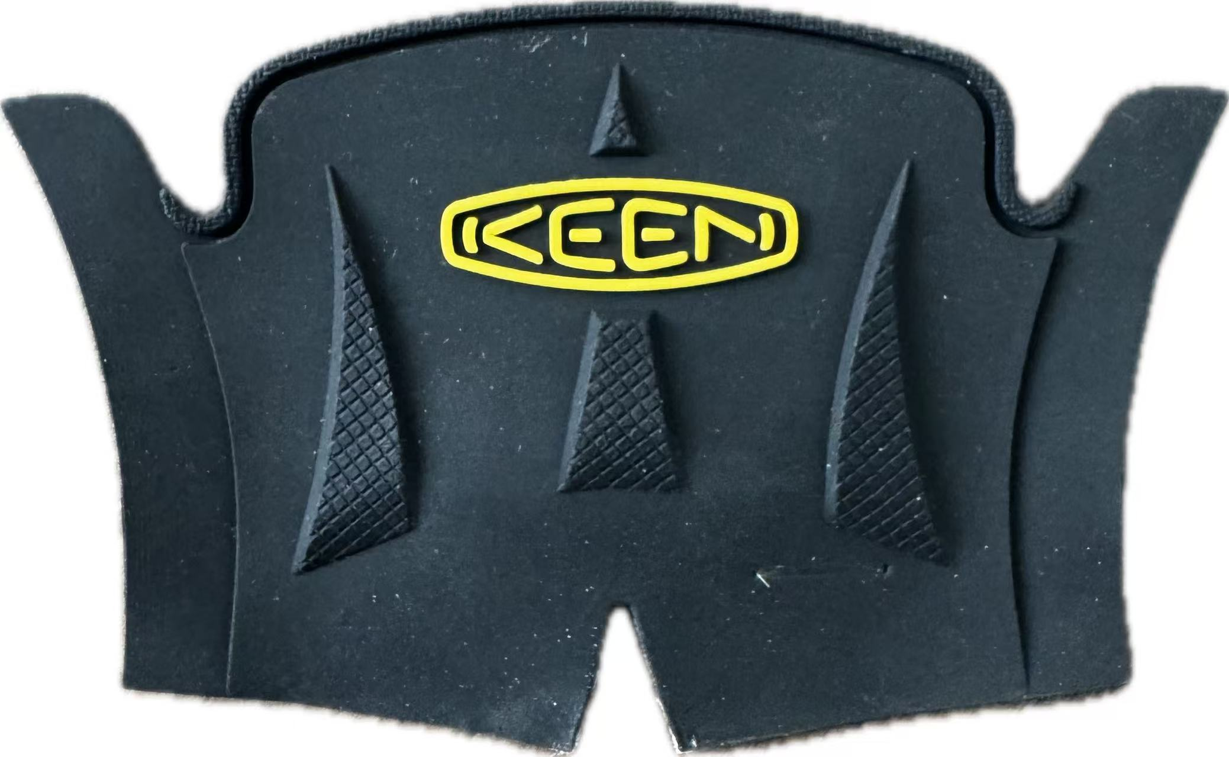
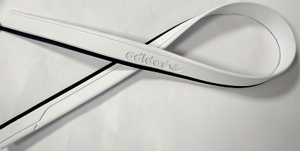
Rubber Product Workshop
Production Capacity
Monthly capacity
Rubber Outsole: 200K/M
Rubber Logo: 1M/M
Foxing Tape: 100K/M
2 sets of rubber compression machines

Slide 16

Capacity Enhancement 2024/2025
Ultimated Production Capacity in South Vietam
Pairs/Month | 2024/12 | 2025/06 | 2025/12
CM | 150,000 | 250,000 | 450,000
CM: 450K/Month
R-MAT

Slide 17
R-Mat Material Introduction

Slide 18

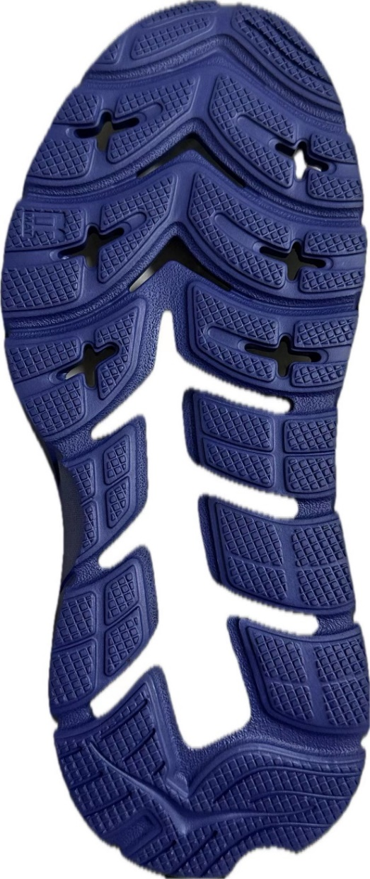
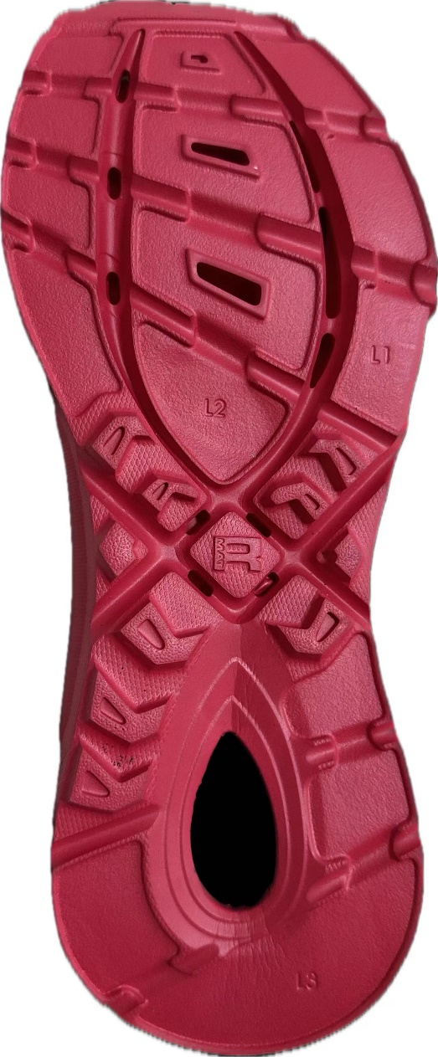
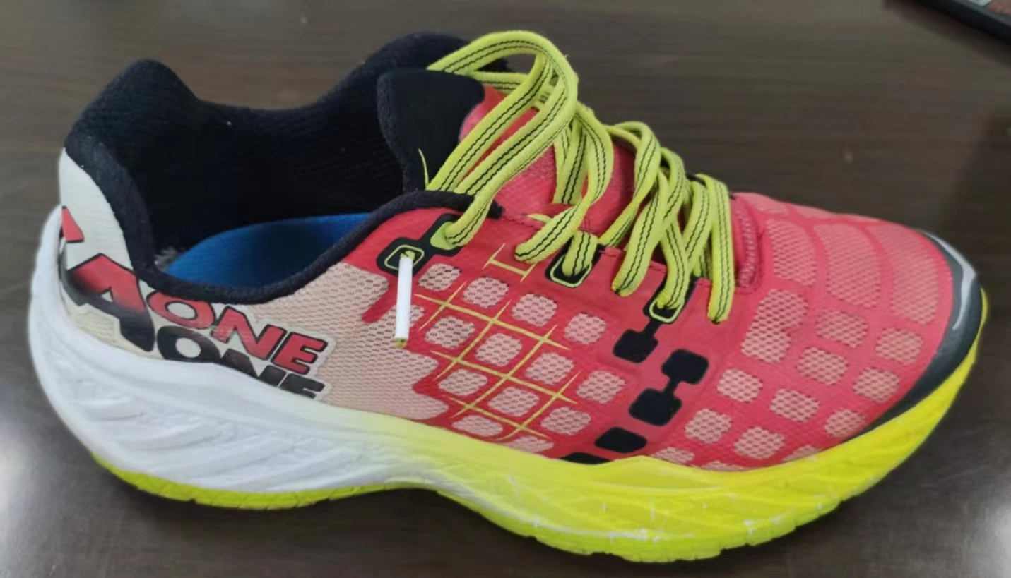
The Story Between R-MAT and HOKAONEONE
In 2014, R-MAT participated in HOKAONEONE's development and jointly
proposed new concepts of different hardness with high rebound.
In 2014, after R-MAT participated in, HOKAONEONE's order increased from
tens of thousands of pairs to millions of pairs.
Previously, Some of HOKAONEONE's midsole and outsole which used R-MAT’s Material
would have R-MAT's logo
According to a survey conducted by HOKAONEONE to consumers, R-MAT's materials are
more comfortable than EVA, which is also the reason why consumers choose them

Slide 19
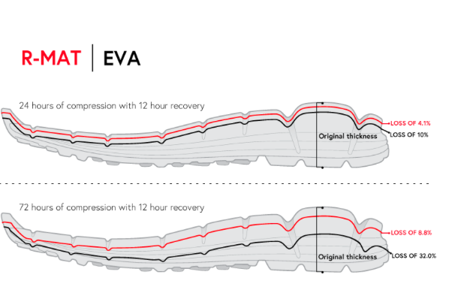

Better cushioning
The wear testers tell us the ride is like a comfortable glide.
Comfort level
8.6
10
6.1
8
6
4
2
R-MAT
MD+RB

Slide 20
Material Advantages and Features
Features:
•Independent Material Development and Research:
We own an independent company dedicated to material development
and research, with a team of 20 experienced technicians.
•Market-Driven R&D:
Each year, we develop materials that align with market trends to ensure
our offerings meet evolving market needs.
•Customized Material Development:
Drawing from our extensive expertise, we also develop materials
tailored specifically to our clients unique requirements.
•Tailored Solutions for Diverse Brands:
For brands across different industries, we conduct specialized research
and development to create materials that meet the specific needs of their finished products.
Advantages:
Outstanding Physical Properties and Authoritative Certifications:
Our existing materials have excellent physical properties and each one has been certified by third-party organizations to ensure quality.
Durability, High Rebound, and Ultra-Light Characteristics:
Compared to other materials, ours offer significant advantages in terms of durability, high rebound, and lightweight properties.
Unique Texture and Elasticity:
Products made with our materials offer a very bouncy texture, providing an exceptional user experience.

Slide 21

R-MAT Material with Outsole & Midsole & Sockliner
01
03
Performance
Cush Comfort
CM R-MAT 2.0 HRLW1 45C 70 Midsole
CM R-MAT 2.0 HRLW2 40C 70 Midsole
IM R-MAT 1.0 HA1 48C Midsole/Outsole
CM R-MAT CM 62C 033 100 Outsole
R-MAT SOCKLINER – CM 25C
R-MAT – CM 30C FR
R-MAT SOCKLINER–CM 35C
R-MAT – DC 35C
02
04
Casual Style
BioBase
R-MAT-IM 150 45C
R-MAT-IM 130 65C
R-MAT-IM 120 70C
R-MAT-IM 150 35C& 50C
R-MAT-IM 145 52C&58C
CM 45+/-3C R-MAT HRL( Version 2.0 in 2023 with 62% Bio-based)
CM 62+/-3C Regular R-MAT & Bio-based R-MAT Comparison
R-MAT

Slide 22
CM R-MAT 1.0 CM 45C 016 60 Midsole
Noted: This material has individual physical properties. If you need to test, please refer to R-MAT standards. Thanks!
This is the midsole material that we have carefully improved based on the first generation. It has achieved an all-round upgrade in comprehensive physical properties. Although the rebound and density are not at the highest level among our products, it can still bring you an outstanding wearing experience. Whether it's for daily jogging or casual sports, it can provide you with just the right amount of support and comfort, allowing you to fully enjoy your sports time. Moreover, this material has an advantage in terms of price. Compared with other high-performance midsole materials of the same type, its cost will be reduced, enabling you to obtain a higher cost-performance ratio while ensuring the product quality.
Test Items | Method | Unit | Std. | Third Party Test Result
Hardness | Adidas GE-09 | Asker C | 45+/-3c | 47C
Density | Adidas GE-14 | g/cm³ | 0.16+/-0.02 | 0.171
Resilience | Adidas GE-12 | % | Min.60 | 67
Comp.Set (6hrs,. 45°） | Adidas GE-13 | % | Max.50 | 46
Shrinkage (1hrs., 70°) | Adidas GE-16 | % | Max.2.0 | Length: 1.6 Width: 0.9
Split Tear | Adidas ST-02 | Kg/cm | Min.2.5 | 2.8
Tensile Strength | Adidas ST-03 | Kg/cm² | Min.20.0 | Length: 45.6 Width: 38.6
Breaking Elongation | Adidas ST-03 | % | Min.200 | Length: 299 Width: 318

Slide 23
CM R-MAT 2.0 40C 013 70 Midsole
Noted: This material has individual physical properties. If you need to test, please refer to R-MAT standards. Thanks!
For this material, it is more suitable for running, with adjustments in hardness. The soft yet supportive hardness, combined with ultra-high rebound and ultra-light weight, is definitely the most suitable material for running. Meanwhile, R-Mat has a unusual feature which is Anti-Wrinkle. Also, for compression molded has the different advantages, such as good dimensional stability, with few restrictions on appearance design.
Test Items | Method | Unit | Std. | Third Party Test Result
Hardness | GE-09 | Asker C | 40+/-3c | 41C
Density | GE-14 | g/cm³ | 0.12+/-0.02 | 0.121
Resilience | GE-12 | % | Min.70 | 73.4
Comp.Set (6hrs,. 45°） | GE-13 | % | Max.50 | 45
Shrinkage (1hrs., 70°) | GE-16 | % | Max.2.0 | Length: 1.8 Width: 1.6
Split Tear | ST-02 | Kg/cm | Min.1.8 | Length: 2.0 Width: 2.0
Tensile Strength | ST-03 | Kg/cm² | Min.20.0 | Length: 34 Width: 33
Breaking Elongation | ST-03 | % | Min.200 | Length: 395 Width: 381
R-MAT

Slide 24
CM R-MAT 2.0 45C 014 70 Midsole
Noted: This material has individual physical properties. If you need to test, please refer to R-MAT standards. Thanks!
This material demonstrates outstanding performance across a range of physical properties, with particular emphasis on rebound and density. It also presents exceptional energy return, rendering it highly appropriate for high-intensity athletic pursuits such as marathons, competitive racing, and outdoor adventures.
Test Items | Method | Unit | Std. | Third Party Test Result
Hardness | Adidas GE-09 | Asker C | 45+/-3c | 46
Density | Adidas GE-14 | g/cm³ | 0.14+/-0.02 | 0.132
Resilience | Adidas GE-12 | % | Min.70 | 73.5
Comp.Set (6hrs,. 45°） | Adidas GE-13 | % | Max.45 | 42
Shrinkage (1hrs., 70°) | Adidas GE-16 | % | Max.2.0 | Length:1.8 Width:1.6
Split Tear | Adidas ST-02 | Kg/cm | Min.2.0 | 2.1
Tensile Strength | Adidas ST-03 | Kg/cm² | Min.20.0 | Length: 46.6 Width: 34.5
Breaking Elongation | Adidas ST-03 | % | Min.200 | Length: 386 Width: 306

Slide 25
CM R-MAT CM 62C 033 100 Outsole
Noted: This material has individual physical properties. If you need to test, please refer to R-MAT standards. Thanks!
R-MAT, a next-generation molded material, is designed for direct ground contact. Compared to traditional rubber outsoles, R-MAT offers lower density, resulting in a significantly lighter weight while maintaining impressive rebound resilience. This innovative material achieves a balance between weight reduction and **enhanced cushioning, delivering superior performance for dynamic applications.
Test Items | Method | Unit | Std. | Third Party Test Result
Hardness | Adidas GE-09 | Asker C | 62+/-3c | 65
Density | Adidas GE-14 | g/cm³ | 0.33+/-0.02 | 0.346
Resilience | Adidas GE-12 | % | Min.35 | 40
Comp.Set (6hrs,. 45°） | Adidas GE-13 | % | Max.50 | 42
Shrinkage (1hrs., 70°) | Adidas GE-16 | % | Max.2.0 | Length:1.8 Width:1.6
Split Tear | Adidas ST-02 | Kg/cm | Min.2.5 | 3.0
Din Abrasion | Adidas GE-27 | g/cm² | 100±30 | 98
Split Resistance | Adidas ST-03 | mm | Dry:0.8 Wet: 0.6 | Dry:0.85 Wet: 0.65

Slide 26
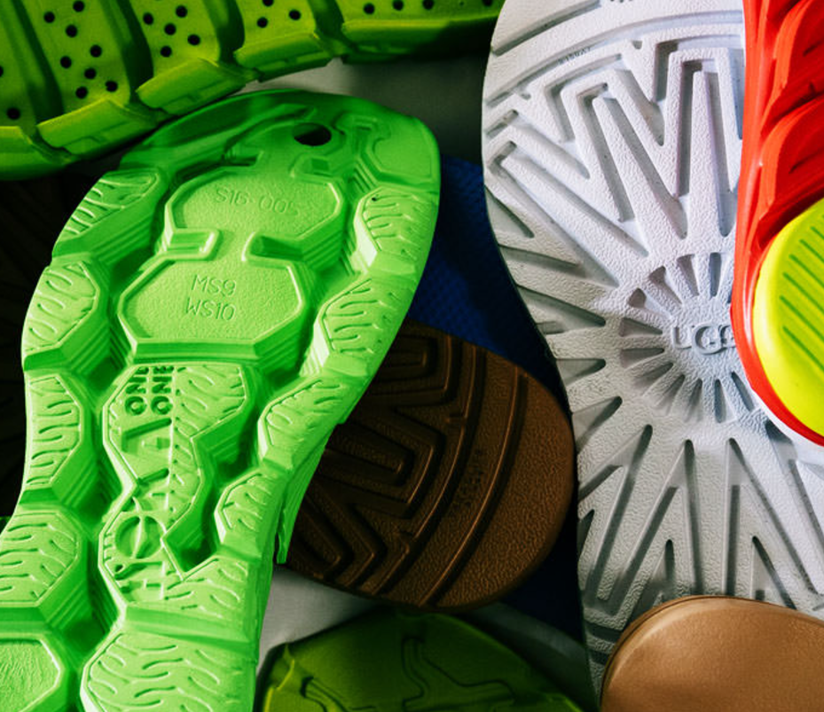
Thank You

